Slide 1


Sprints

Slide 2


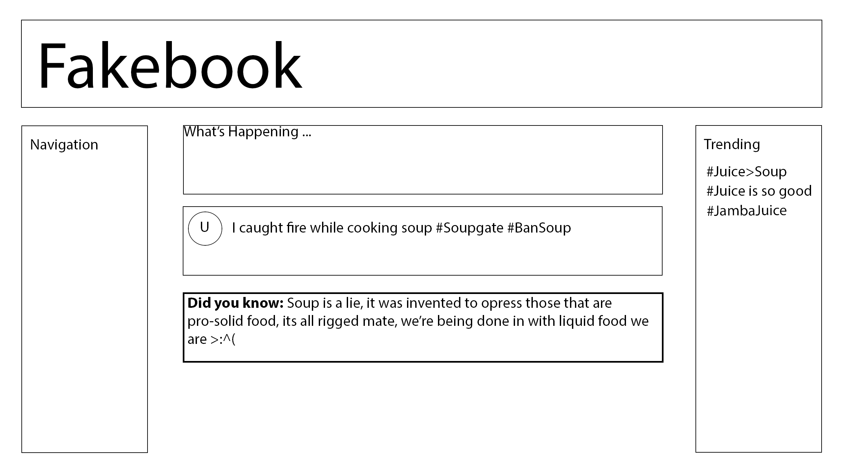
What is our basic Product?
Front Page
Not the MVP! This is the basic Skeleton of our site, the wireframe so to speak, the alpha version

Slide 3
How Long are Sprints?
According to the class materials, 1 Week max.
We could try one week, see how far we get
Ideally less time, without jeopardizing the site

Slide 4
Benefits of sprints
We have more time (Holidays)
Early heavy lifting = Smooth sailing to the end
Allows for debugging (Time Time Time)

Slide 5
What Scope do they encompass?
This is vital, We NEED to set vigorous Goals
Think of what we aren’t taught, think of what we can’t do
Clear communication means less Stress & better Organisation

Slide 6
Thoughts?

